Slide 1
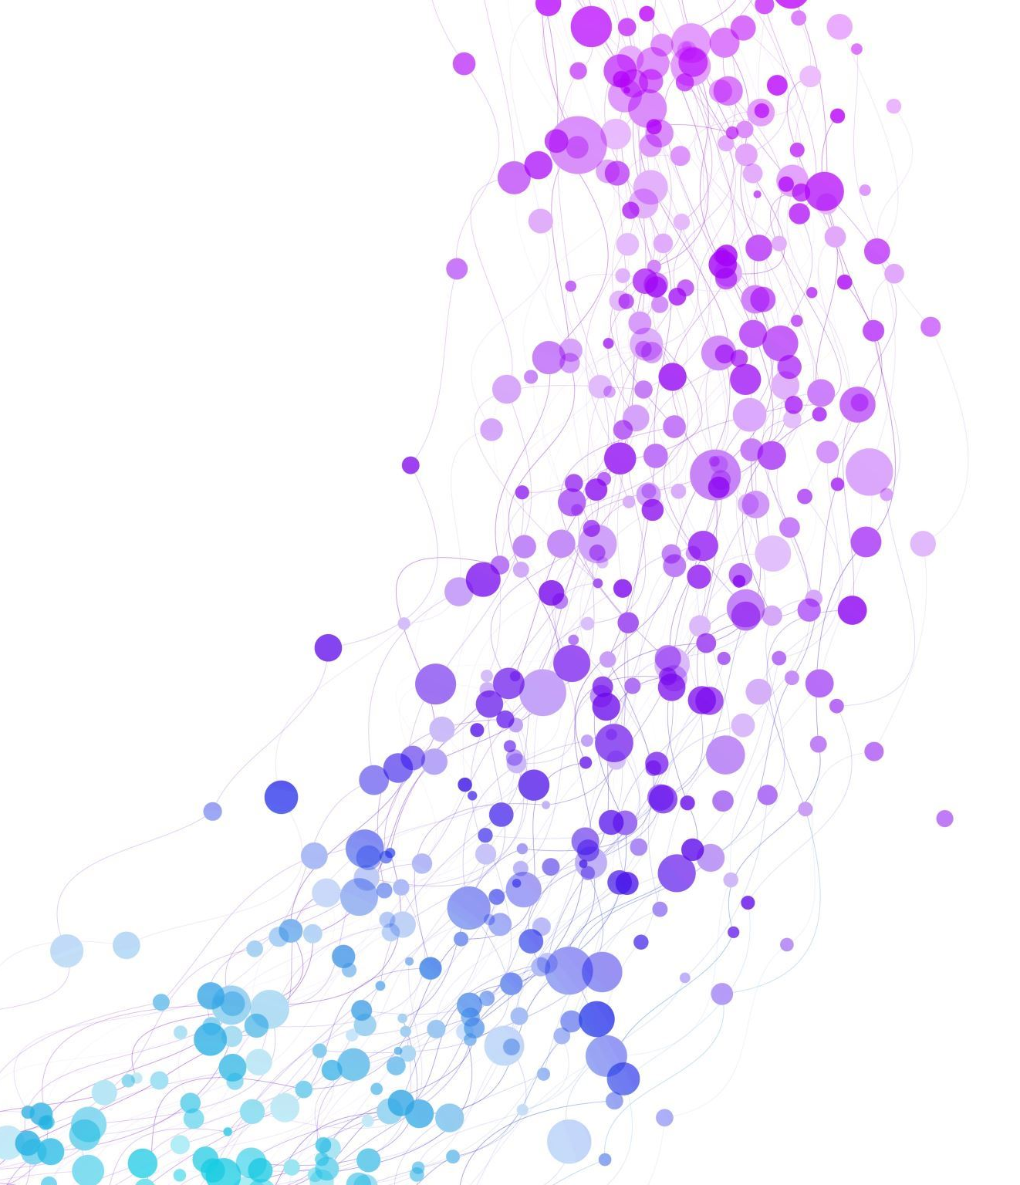
Movie Recommender System
By Abhinash Joshi
Kalpesh Patil
Rohan Mahajan
Aditya Mali
Guided by Ashwini Mam
External :

Slide 2
Introduction
Content – Based Recommender System
Content-based filtering is a recommendation technique that suggests items based on the features of the Movie.
In the context of movie recommendation systems, content-based filtering recommends movies that are similar in content to those that a user has liked in the past.

Slide 3
Objectives
Personalization: Provide personalized movie recommendations based on user preferences.
Enhance User Experience: Improve user satisfaction by suggesting relevant and interesting movies.
Increase Engagement: Keep users engaged by offering a variety of movie options.
Boost Revenue: Increase movie rentals, purchases, or subscriptions through targeted recommendations.
Improve Content Discovery: Help users discover new movies they might enjoy.

Slide 4
Overview
Movie Representation:
Each movie in the system is represented by a set of features. These features can include genres, id, keywords, title, overview, cast, crew.
Similarity Calculation: Cosine similarity is a metric, helpful in determining, how similar the data objects are irrespective of their size.
In cosine similarity, data objects in a dataset are treated as a vector , The formula to find the cosine similarity between two vectors is (x, y) = x . y / ||x|| ||y|| .
Where, x . y = product (dot) of the vectors ‘x’ and ‘y’.
||x|| and ||y|| = length (magnitude) of the two vectors ‘x’ and ‘y’.
||x|| ||y|| = regular product of the two vectors ‘x’ and ‘y’.

Slide 5
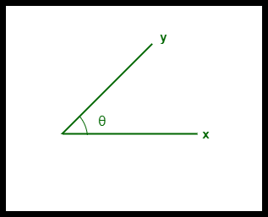
Overview:
The cosine similarity between two vectors is measured in ‘θ’.
If θ = 0°, the ‘x’ and ‘y’ vectors overlap, thus proving they are similar.
If θ = 90°, the ‘x’ and ‘y’ vectors are dissimilar.

Slide 6
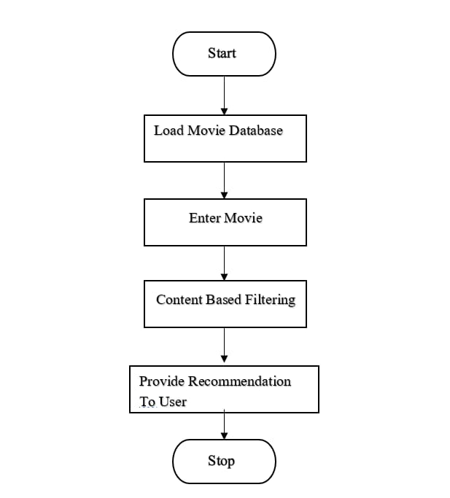
Flowchart:

Slide 7
Vectorization
Vectorization is the process of converting textual data into numerical vectors and is a process that is usually applied once the text is cleaned. It can help improve the execution speed and reduce the training time of your code.
Vectorization techniques:
There are three major methods for performing vectorization on text data:
1. CountVectorizer
2. TF-IDF
3. Word2Vec

Slide 8
Vectorization Technique
CountVectorizer
CountVectorizer is one of the simplest techniques that is used for converting text into vectors. It starts by tokenizing the document into a list of tokens (words).
It selects the unique tokens from the token list and creates a vocabulary of words.
Finally, a sparse matrix is created containing the frequency of words, where each row represents different sentences and each column represents unique words.

Slide 9
THANK YOU

